Slide 1
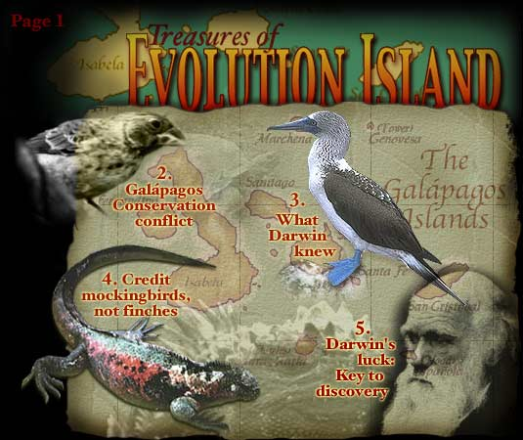

Slide 2
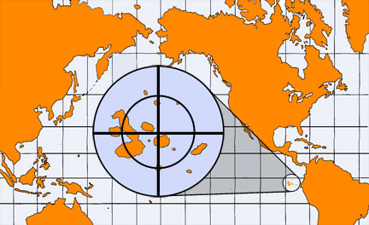
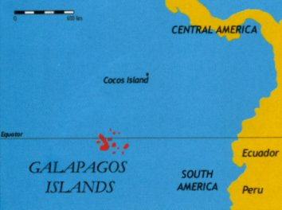
Galapagos Islands Location

Slide 3
40 % of the animals on the Galapagos are only found there, although scientists think they originated in South America. –
Why are they so different from similar animals in South America?

Slide 4
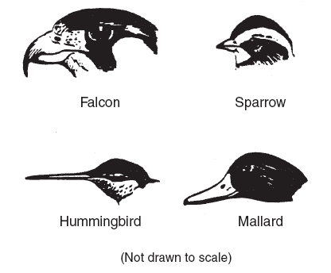
The diagram shows the head structure of four different birds.
The birds’ beaks show how the birds
(1) compete for the same food in their community
(2) require different amounts of food for survival
(3) store food for the winter months
(4) are adapted to get food from different sources
http://www.vtaide.com/png/bird-adaptations3.htm

Slide 5
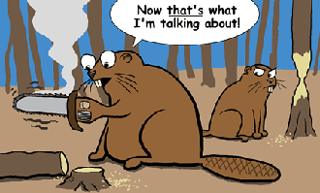
Darwin theorized that species can change to adapt to their environment and become different.

Slide 6
Survival of the Fittest

Slide 7
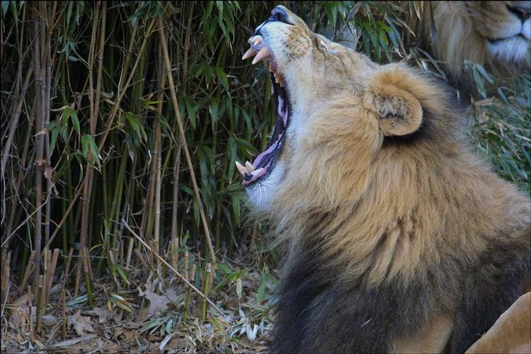
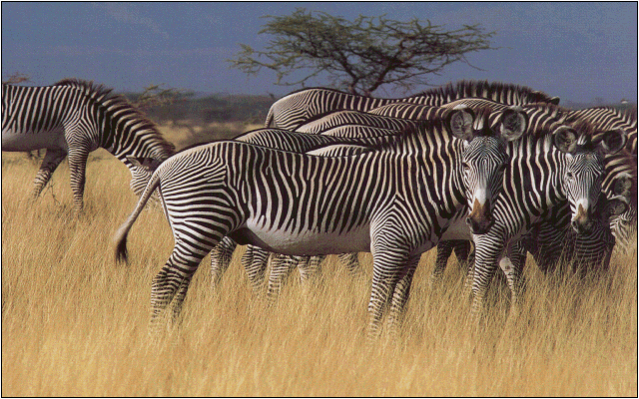
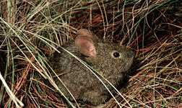
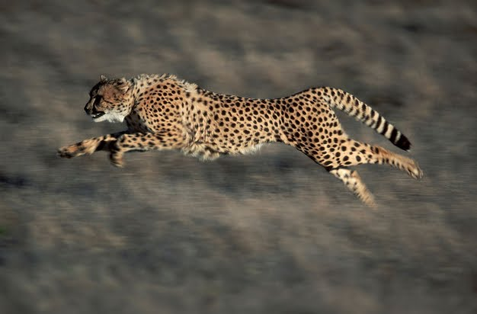
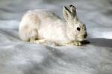
What adaptations do predators have to help them get their food?
Name adaptations that prey have to help them escape?

Slide 8
Evolution Rap
http://www.flocabulary.com/evolution/

Slide 9
Videos
http://www.brainpop.com/science/famousscientists/charlesdarwin/
http://www.brainpop.com/science/ecologyandbehavior/naturalselection/
http://studyjams.scholastic.com/studyjams/jams/science/animals/animal-adaptations.htm

Slide 10
Games
http://www.sciencechannel.com/games-and-interactives/charles-darwin-game.htm
http://www.pbslearningmedia.org/asset/lsps07_int_buildafish/
http://switchzoo.com/zoo.htm
http://www.ecokids.ca/PUB/eco_info/topics/climate/adaptation_quiz/play_quiz.cfm

Slide 11
Embryos
http://www.pbs.org/wgbh/nova/evolution/guess-embryo.html

